Slide 1
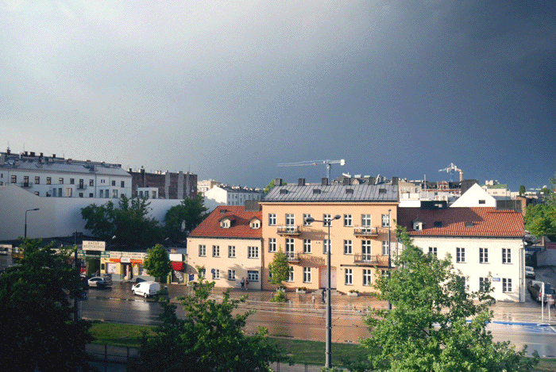
Company Name / Logo
System / Portfolio Name
Interactive Architecture Q2 2020
Author & Title
Date
Version or Draft
Cinemagraph Source: Maryanski

Slide 2
Intent and Features of this Template
Architectural Modeling Methodology
The intent of this template is to provide an interactive point-in-time system, roadmap, or solution architecture via a ZUI (Zooming User Interface).
This template utilizes advanced features of Microsoft PowerPoint 365 such as:
Slide Zoom for impactful understanding of depth
Linked Shapes for easier navigation
Animated GIFs for conveying ideas and concepts
Grouped shapes for quick modeling
3D Shapes + Animations for engaging visuals
Cinemagraphs (see title slide)
The methodology prescribed here could be described as TOGAF-like with UML-lite annotations. Simple and light.
System Overview
Subsystem Views
Component Views
Interface/Integration Sequence Views
Point-in-time legend/key (For Road-mapping)
Current
New
Modified
Retire
Click above for shape definitions and context
Remove this Slide before Publishing
This template is FREE for use by any organization or business. Created by Jesse Myer @ jessemyer.com

Slide 3
Intro / Overview
Opportunity
Introduce the viewer or audience here to the proposed cadence and subject matter of this document/deck. It should be generic enough for anyone to begin understanding the purview, scope, and topic of the architecture being introduced and covered. For this template, Subsystem 1 contains some details that are typical to a web based application or platform. The rest of the slides are generic in nature but varied for easier copying and pasting of their constituent parts.
This area should be used to introduce the readers to any sort of challenge or problem. It can be conversely titled “Opportunities” or any other myriad of ‘selling’ points to provide a point of view or perspective relevant to the portfolio, systems, or roadmap being detailed in these slides.
In general the problem statement of this document is that often there is no prescribed notation for architecture slides in an organization, or they are so far deprecated as to be entirely uninteresting or relevant. The challenge here, is creating a new template that might be easy to use for novice and expect architects alike.
Navigation

Slide 4
Architecture Roadmap – Q2 2020
Note: Interface 2 to 4
One of the often missed details of any architecture are impactful system or subsystem to subsystem interfaces. Use individual interface slides to narrow in on integration details.
Link to Intro/Overview
This icon will default to link to the intro/overview slide, edit link on any link to change slide target for zoom navigating.
Firewall – Name it
Note: Subsystem 1
This is a place for notes on current highlights of change, modification, or potential technical risk, debt, or currency changes.
Note: Interfaces No-Glow
For aesthetic reasons interface slides should not include a glow border.
Note: Subsystem 3
This is a place for notes on current highlights of change, modification, or potential technical risk, debt, or currency changes.
current
new
modify
retire
glow: click to navigate

Slide 5
Subsystem 1
Note: Titles and Transparent Notes
Keep the titles of any slides bold and large so they can be seen when zoomed out or in a macro view mode.
Note shapes are generally transparent.
Note: Colors and Glows
Be very deliberate on your usage of colors to denote point-in-time, iterative, or evolution of architecture. Architecture is best used to plan and design, not just capturing of current state.
Use a Tier-2 of glow to denote linking.
current
new
modify
retire
glow: click to navigate

Slide 6
Subsystem 1 : Component 1
Note: Link Endpoints
Always link endpoints for easier navigation when presenting or reading.
Desktop
Browser
<< dns >>
System.com
<< routing >>
System.com
<< load balancing >>
Load Balancer System
<< routing>>
Reactive Routing
https
https
https
https
Native
Mobile
<< service >>
Regional Lookup
Note: Always Note Changes
Any change in design or architecture should be accompanied by a note detailing what exactly might be changing; even if it this is a note or link to more details.
current
new
modify
retire
glow: click to navigate

Slide 7
Subsystem 1 : Component 2
<< service >>
Name / tech
Note: Are Resizable
Resize notes for optimum screen space.
protocol
Desktop
Browser
Message
<< type >>
Name / tech
<< type >>
Name / tech
<< type >>
Name / tech
protocol
protocol
protocol
<< service >>
Name / tech
current
new
modify
retire
glow: click to navigate

Slide 8
Subsystem 1 : Component 3
<< service >>
Name / tech
protocol
Message
<< type >>
Name / tech
<< type >>
Name / tech
<< type >>
Name / tech
Message
protocol
protocol
protocol
<< service >>
Name / tech
current
new
modify
retire
glow: click to navigate

Slide 9
Subsystem 1 : Component 4
Message
<< service >>
Name / tech
<< service >>
Name / tech
protocol
protocol
<< service >>
Name / tech
protocol
Message
<< type >>
Name / tech
<< type >>
Name / tech
protocol
protocol
current
new
modify
retire
glow: click to navigate

Slide 10
Subsystem 2
current
new
modify
retire
glow: click to navigate

Slide 11
Subsystem 2 : Component 1
Message
<< dns >>
System.com
<< routing >>
System.com
<< load balancing >>
Load Balancer System
https
https
https
https
<< service >>
Regional Lookup
current
new
modify
retire
glow: click to navigate

Slide 12
Subsystem 2 : Component 2
<< service >>
Name / tech
protocol
Message
<< type >>
Name / tech
<< type >>
Name / tech
<< type >>
Name / tech
Message
protocol
protocol
protocol
<< service >>
Name / tech
current
new
modify
retire
glow: click to navigate

Slide 13
Subsystem 2 : Component 3
<< service >>
Name / tech
protocol
Message
<< type >>
Name / tech
<< type >>
Name / tech
<< type >>
Name / tech
protocol
protocol
Message
current
new
modify
retire
glow: click to navigate

Slide 14
Subsystem 3
Note: Zoom Optional
Sometimes component models do not require a zoom, it is discretionary what level of detail may be required or known.
Message
protocol
protocol
protocol
protocol
<< JDBC >>
Name / tech
<< ORM >>
Name / tech
<< DBACCESS >>
Name / tech
<< JSON >>
Name / tech
protocol
protocol
protocol
protocol
<< data file >>
Unstructured Data
Note: Be Pragmatic
Although database shapes as shown above are not typically UML format, they are synonymous objects found to represent ‘databases’ or ‘datastores’ in just about any architectural methodology. Be pragmatic.
Note: Schemas as Solutions
Data might be king! In some cases drill-downs into schemas may solidify the scope or drive requirements in a meaningful manner.
current
new
modify
retire
glow: click to navigate

Slide 15
Subsystem 3 : Database 1
Table Name
PK | id | GUID
 | someInt | INT
 | someData | VARCHAR(45)
 | someBoolean | BOOLEAN
Table Name
PK | id | GUID
 | someInt | INT
 | someData | VARCHAR(45)
 | someBoolean | BOOLEAN
Table Name
PK | id | GUID
 | someInt | INT
 | someData | VARCHAR(45)
 | someBoolean | BOOLEAN
Table Name
PK | id | GUID
 | someInt | INT
 | someData | VARCHAR(45)
 | someBoolean | BOOLEAN
Table Name
PK | id | GUID
 | someInt | INT
 | someData | VARCHAR(45)
 | someBoolean | BOOLEAN
Note: Data Scope
More often than not, solutions are using shared databases, not all data might be in scope for the solution at hand. Grey-out schemas that may not pertain to the scope.
current
new
modify
retire
glow: click to navigate

Slide 16
Subsystem 3 : Database 2
Table Name
PK | id | GUID
 | someInt | INT
 | someData | VARCHAR(45)
 | someBoolean | BOOLEAN
Table Name
PK | id | GUID
 | someInt | INT
 | someData | VARCHAR(45)
 | someBoolean | BOOLEAN
Table Name
PK | id | GUID
 | someInt | INT
 | someData | VARCHAR(45)
 | someBoolean | BOOLEAN
current
new
modify
retire
glow: click to navigate

Slide 17
Subsystem 3 : Database 3
Table Name
PK | id | GUID
 | someInt | INT
 | someData | VARCHAR(45)
 | someBoolean | BOOLEAN
Table Name
PK | id | GUID
 | someInt | INT
 | someData | VARCHAR(45)
 | someBoolean | BOOLEAN
current
new
modify
retire
glow: click to navigate

Slide 18
Subsystem 4
current
new
modify
retire
glow: click to navigate

Slide 19
Subsystem 4 : Component 1
Message
<< class >>
Token
<< class >>
Logic 1
<< class >>
Passthrough
https
https
https
<< framework >>
Logic Framework
current
new
modify
retire
glow: click to navigate

Slide 20
Subsystem 4 : Component 2
Message
Message
<< type >>
Name / tech
<< type >>
Name / tech
<< type >>
Name / tech
protocol
protocol
Message
protocol
<< service >>
Name / tech
current
new
modify
retire
glow: click to navigate

Slide 21
Subsystem 4 : Component 3
<< ldap >>
users
<< framework >>
oauth
<< agent >>
DLP
https
https
Message
current
new
modify
retire
glow: click to navigate

Slide 22
Subsystem 4 : Database 1
Table Name
PK | id | GUID
 | someInt | INT
 | someData | VARCHAR(45)
 | someBoolean | BOOLEAN
Table Name
PK | id | GUID
 | someInt | INT
 | someData | VARCHAR(45)
 | someBoolean | BOOLEAN
current
new
modify
retire
glow: click to navigate

Slide 23
Subsystem 4 : Component 4
<< service >>
Name / tech
protocol
<< type >>
Name / tech
<< type >>
Name / tech
<< type >>
Name / tech
protocol
protocol
protocol
<< service >>
Name / tech
Message
current
new
modify
retire
glow: click to navigate

Slide 24
Interface 1 2
:RESTRequest1
Subsystem 1
Component 1.4
:RESTRequest2
Subsystem 2
Component 2.1
token
request
[ GET data1, data2, data3 ]
response
[ ARRAY: data1, data2, data3 ]
current
new
modify
retire
glow: click to navigate

Slide 25
Interface 3 2
:RESTRequest2
Subsystem 2
Component 2.1
C
:RESTRequest1
Subsystem 1
Component 1.4
token
transform
request
[ GET data1, data2, data3 ]
response
[ ARRAY: data1, data2, data3 ]
current
new
modify
retire
glow: click to navigate

Slide 26
Interface 2 4
:RESTRequest1
Subsystem 1
Component 1.4
:RESTRequest2
Subsystem 2
Component 2.1
token
request
[ GET data1, data2, data3 ]
response
[ ARRAY: data1, data2, data3 ]
current
new
modify
retire
glow: click to navigate

Slide 27
Interface 4 ?
:RESTRequest1
Subsystem 1
Component 1.4
:RESTRequest2
Subsystem 2
Component 2.1
token
request
[ GET data1, data2, data3 ]
transform
response
[ ARRAY: data1, data2, data3 ]
current
new
modify
retire
glow: click to navigate

Slide 28
Appendix

Slide 29
Shapes : ‘UML 2.0 lite’
Home Button
Navigate quickly to top-level.
Intro/Overview Button
Navigate quickly back to Intro/Overview
Endpoint
Subsystem
Component
Endpoint
Subsystem
Component
current
Key
Describes the various colors for shapes and their point-in-time status. Glow signifies navigation/links.
new
Sequence Diagram
A complex group of objects that describes a message format, typically used to show interfaces between components or systems in a stacked manner.
modify
request
retire
[ GET data1, data2, data3 ]
glow: click to navigate
transform
response
[ ARRAY: data1, data2, data3 ]
<< type >>
Name
Component
Contains the type of technology in double carets and the name. Used to denote any level of component.
Firewall
Displays a zone of segregation between network zones. Useful to imply required security architectures.
Provided Interface
An interface provided by a component or system to be interacted with or consumed.
Note: Anything
This is a place for notes on current highlights of change, modification, or potential technical risk, debt, or currency changes.
Note
Used to describe the context of any manner of information about particular parts and sections of an architecture.
Firewall – Name it
Required Interface
An connecter, normally used to interface with a provided interface.
Schema
Describes parts of a table or any logical structure of a dataset. Column 1 denotes keys, column 2 is the normal name, and column 3 the data type.
Table Name
PK | id | GUID
 | someInt | INT
 | someData | VARCHAR(45)
 | someBoolean | BOOLEAN
Database
Database
Denotes a database as a stand-alone component. Optionally can be used in place of a component, universally understood in IT.

Slide 30
Resources for Animated Gifs & Cinemagraphs
Use various technical or thematic animated gifs in PowerPoint to better convey a message, concept, theme while engaging the intended audience.
Metrix & Motion Board, Pinterest
Collation of 550+ various animated technical or thematic gifs for use. Try to reference source if possible.

Slide 31
Conceptual Slide : Cloud Computing
Cloud computing is shared pools of configurable computer system resources and higher-level services that can be rapidly provisioned with minimal management effort, often over the Internet. Cloud computing relies on sharing of resources to achieve coherence and economies of scale, similar to a public utility.
Third-party clouds enable organizations to focus on their core businesses instead of expending resources on computer infrastructure and maintenance.[1] Advocates note that cloud computing allows companies to avoid or minimize up-front IT infrastructure costs. Proponents also claim that cloud computing allows enterprises to get their applications up and running faster, with improved manageability and less maintenance, and that it enables IT teams to more rapidly adjust resources to meet fluctuating and unpredictable demand.[1][2][3] Cloud providers typically use a "pay-as-you-go" model, which can lead to unexpected operating expenses if administrators are not familiarized with cloud-pricing models.[4]
Since the launch of Amazon EC2 in 2006, the availability of high-capacity networks, low-cost computers and storage devices as well as the widespread adoption of hardware virtualization, service-oriented architecture, and autonomic and utility computing has led to growth in cloud computing.[5][6][7] From Wikipedia

Slide 32
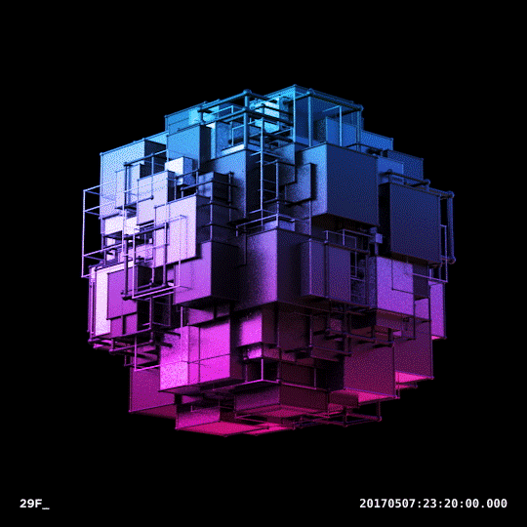
Conceptual Slide : Auto-elasticity
Elasticity aims at matching the amount of resource allocated to a service with the amount of resource it actually requires, avoiding over- or under-provisioning. Over-provisioning, i.e., allocating more resources than required, should be avoided as the service provider often has to pay for the resources that are allocated to the service. For example, an Amazon EC2 M4 extra-large instance costs US$0.239/hour. If a service has allocated two virtual machines when only one is required, the service provider wastes $2,095 every year. Hence, the service provider's expenses are higher than optimal and the profit is reduced.
Under-provisioning, i.e., allocating fewer resources than required, must be avoided, otherwise the service cannot serve its users with a good service. In the above example, under-provisioning the website may make it seem slow or unreachable. Web users eventually give up on accessing it, thus, the service provider loses customers. On the long term, the provider's income will decrease, which also reduces the profit
From Wikipedia

Slide 33
Conceptual Slide : 3D Shapes + Animation
3D shapes can be added by selecting Insert, 3D Shape
To animate a shape, select Animation; Turntable will continually turn the 3D object around

